Slide 1

Introduction
In the latter part of the nineteenth century, George Boole incensed philosophers and mathematicians alike when he suggested that logical thought could be represented through mathematical equations.
How dare anyone suggest that human thought could be encapsulated and manipulated like an algebraic formula?
Computers, as we know them today, are implementations of Boole’s Laws of Thought.
John Atanasoff and Claude Shannon were among the first to see this connection.

Slide 2
Introduction
In the middle of the twentieth century, computers were commonly known as “thinking machines” and “electronic brains.”
Many people were fearful of them.
Nowadays, we rarely ponder the relationship between electronic digital computers and human logic. Computers are accepted as part of our lives.
Many people, however, are still fearful of them.
In this chapter, you will learn the simplicity that constitutes the essence of the machine.

Slide 3
Boolean Algebra
Boolean algebra is a mathematical system for the manipulation of variables that can have one of two values.
In formal logic, these values are “true” and “false.”
In digital systems, these values are “on” and “off,” 1 and 0, or “high” and “low.”
Boolean expressions are created by performing operations on Boolean variables.
Common Boolean operators include AND, OR, and NOT.

Slide 4
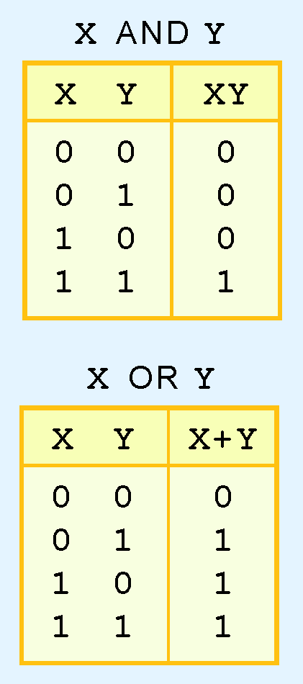
Boolean Algebra
A Boolean operator can be completely described using a truth table.
The truth table for the Boolean operators AND and OR are shown at the right.
The AND operator is also known as a Boolean product. The OR operator is the Boolean sum.

Slide 5
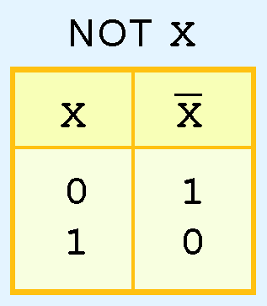
Boolean Algebra
The truth table for the Boolean NOT operator is shown at the right.
The NOT operation is most often designated by an overbar. It is sometimes indicated by a prime mark ( ‘ ) or an “elbow” (¬).

Slide 6
Boolean Algebra
A Boolean function has:
At least one Boolean variable,
At least one Boolean operator, and
At least one input from the set {0,1}.
It produces an output that is also a member of the set {0,1}.
Now you know why the binary numbering system is so handy in digital systems.

Slide 7
Boolean Algebra
Digital computers contain circuits that implement Boolean functions.
The simpler that we can make a Boolean function, the smaller the circuit that will result.
Simpler circuits are cheaper to build, consume less power, and run faster than complex circuits.
With this in mind, we always want to reduce our Boolean functions to their simplest form.
There are a number of Boolean identities that help us to do this.

Slide 8
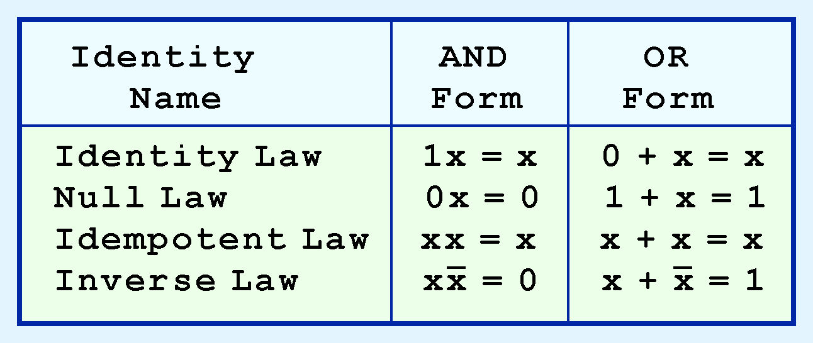
Boolean Algebra
Most Boolean identities have an AND (product) form as well as an OR (sum) form. We give our identities using both forms. Our first group is rather intuitive:

Slide 9
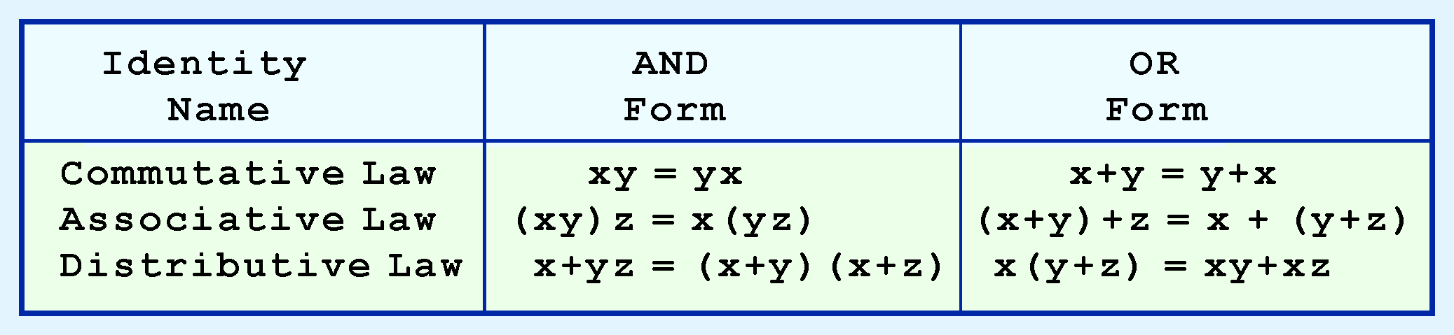
Boolean Algebra
Our second group of Boolean identities should be familiar to you from your study of algebra:

Slide 10
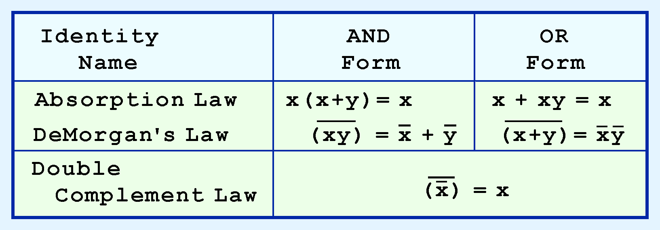
Boolean Algebra
Our last group of Boolean identities are perhaps the most useful.
If you have studied set theory or formal logic, these laws are also familiar to you.

Slide 11

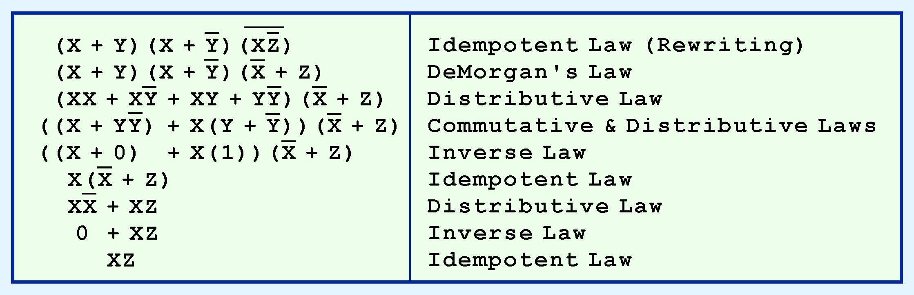
Boolean Algebra
We can use Boolean identities to simplify the function:
as follows:

Slide 12
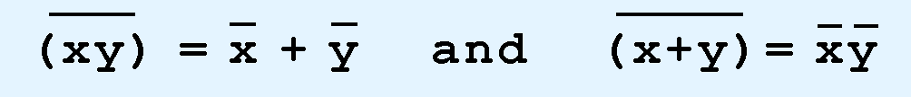
Boolean Algebra
Sometimes it is more economical to build a circuit using the complement of a function (and complementing its result) than it is to implement the function directly.
DeMorgan’s law provides an easy way of finding the complement of a Boolean function.
Recall DeMorgan’s law states:

Slide 13
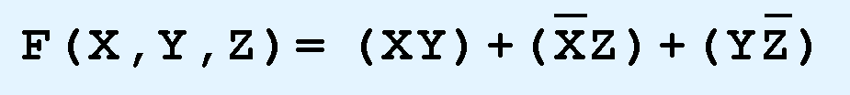
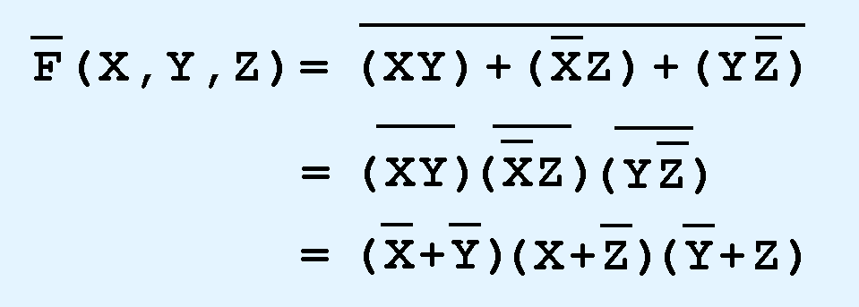
Boolean Algebra
DeMorgan’s law can be extended to any number of variables.
Replace each variable by its complement and change all ANDs to ORs and all ORs to ANDs.
Thus, we find the complement of:
is:

Slide 14
Boolean Algebra
Through our exercises in simplifying Boolean expressions, we see that there are numerous ways of stating the same Boolean expression.
These “synonymous” forms are logically equivalent.
Logically equivalent expressions have identical truth tables.
In order to eliminate as much confusion as possible, designers express Boolean functions in standardized or canonical form.

Slide 15
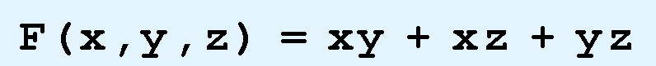
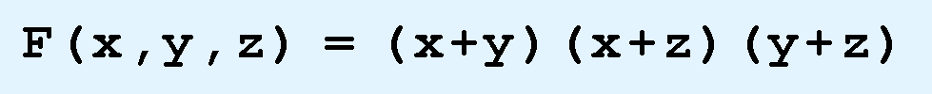
Boolean Algebra
There are two canonical forms for Boolean expressions: sum-of-products and product-of-sums.
Recall the Boolean product is the AND operation and the Boolean sum is the OR operation.
In the sum-of-products form, ANDed variables are ORed together.
For example:
In the product-of-sums form, ORed variables are ANDed together:
For example:

Slide 16
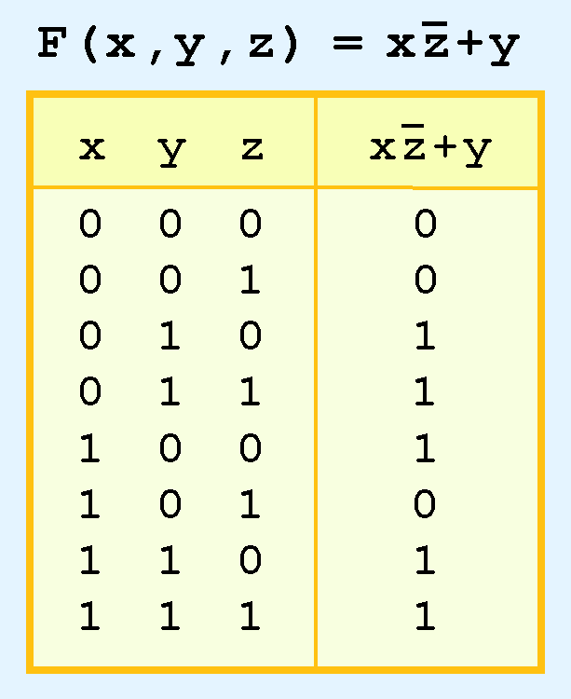
Boolean Algebra
It is easy to convert a function to sum-of-products form using its truth table.
We are interested in the values of the variables that make the function true (=1).
Using the truth table, we list the values of the variables that result in a true function value.
Each group of variables is then ORed together.

Slide 18
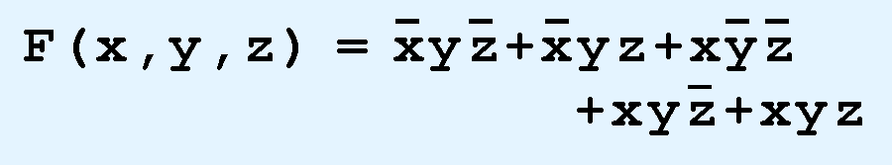
Boolean Algebra
The sum-of-products form for our function is:
We note that this function is not in simplest terms. Our aim is only to rewrite our function in canonical sum-of-products form.

Slide 27
Logic Gates
We have looked at Boolean functions in abstract terms.
In this section, we see that Boolean functions are implemented in digital computer circuits called gates.
A gate is an electronic device that produces a result based on two or more input values.
In reality, gates consist of one to six transistors, but digital designers think of them as a single unit.
Integrated circuits contain collections of gates suited to a particular purpose.

Slide 28
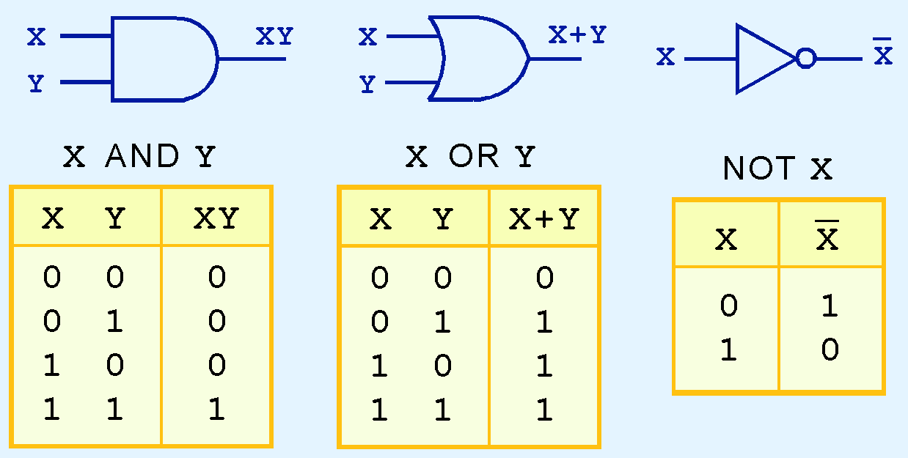
Logic Gates
The three simplest gates are the AND, OR, and NOT gates.
They correspond directly to their respective Boolean operations, as you can see by their truth tables.

Slide 29
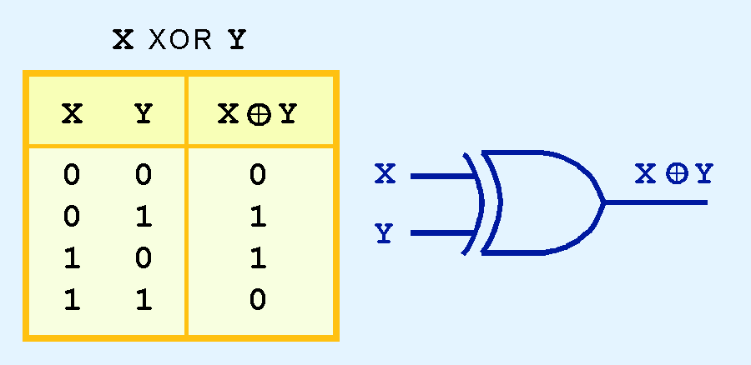
Logic Gates
Another very useful gate is the exclusive OR (XOR) gate.
The output of the XOR operation is true only when the values of the inputs differ.
Note the special symbol ⊕ for the XOR operation.

Slide 32
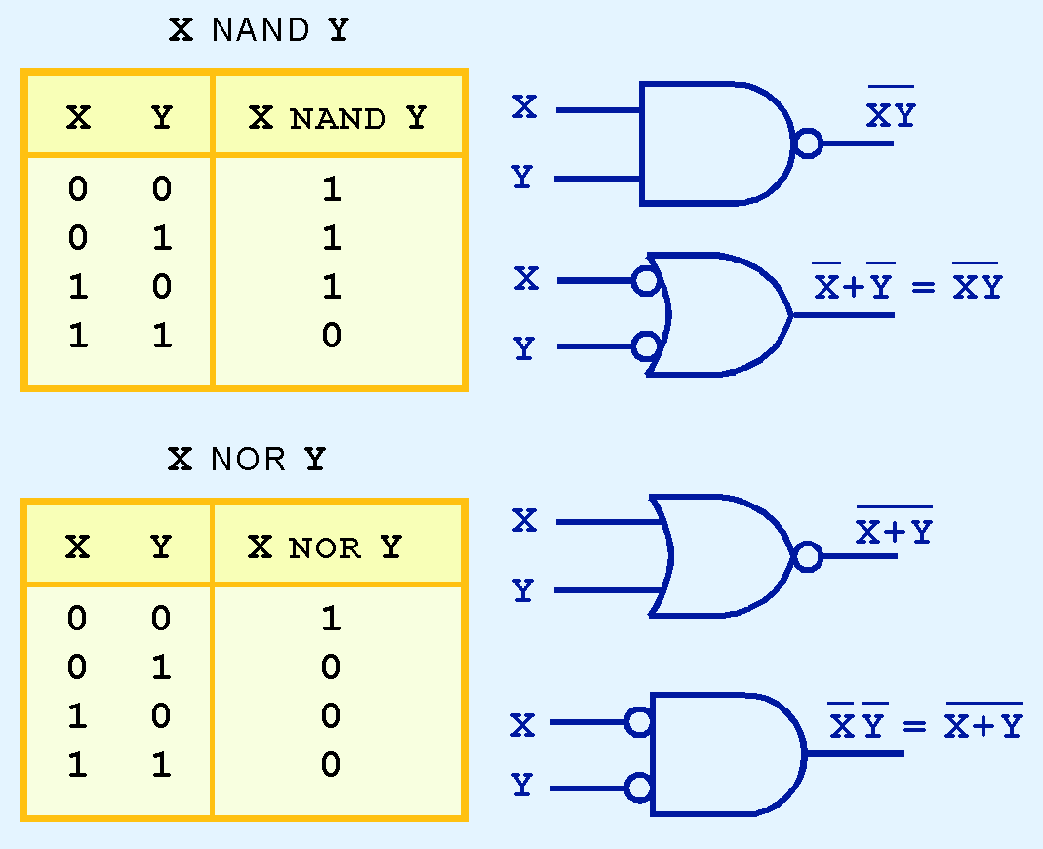
Logic Gates
NAND and NOR are two very important gates. Their symbols and truth tables are shown at the right.

Slide 33
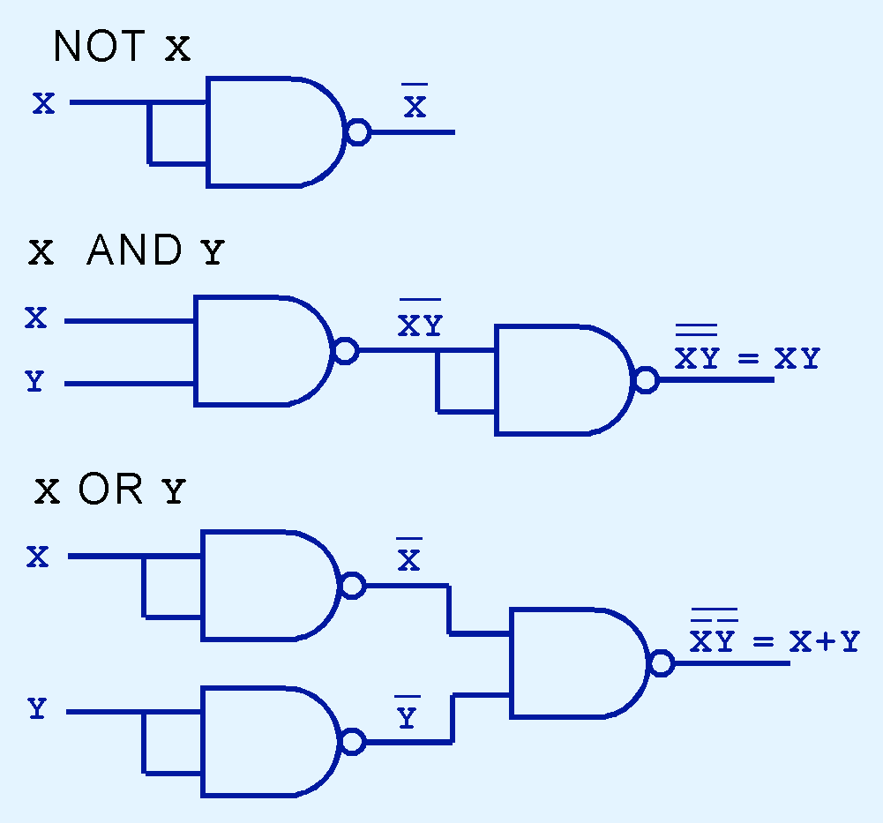
Logic Gates
NAND and NOR are known as universal gates because they are inexpensive to manufacture and any Boolean function can be constructed using only NAND or only NOR gates.

